Slide 1

Project Presentation On “Micro-Credit Defaulter Model”
Presented By Prashant Shekhar

Slide 2
Agenda:
Overview.
Problem Statement.
Problem Understanding.
What is Micro Credit?
Importance of Micro Credit Defaulter Model.
Exploratory data analysis.
Visualizations.
Analysis.
Data cleaning steps.
Data Balancing.
Model Building.
Conclusion.

Slide 3
Overview:
In this particular presentation we will be looking on:
How to analyze the dataset of Micro Credit Defaulters.
What are the EDA steps in cleaning the dataset.
Overall analysis on the problem.
Model building from the cleaned dataset.
Predicting defaulters for saved model.

Slide 4
Problem Statement:
A Microfinance Institution (MFI) is an organization that offers financial services to low income populations. MFS becomes very useful when targeting especially the unbanked poor families living in remote areas with not much sources of income. The Microfinance services (MFS) provided by MFI are Group Loans, Agricultural Loans, Individual Business Loans and so on. Many microfinance institutions (MFI), experts and donors are supporting the idea of using mobile financial services (MFS) which they feel are more convenient and efficient, and cost saving, than the traditional high-touch model used since long for the purpose of delivering microfinance services. Though, the MFI industry is primarily focusing on low income families and are very useful in such areas, the implementation of MFS has been uneven with both significant challenges and successes. Today, microfinance is widely accepted as a poverty-reduction tool, representing $70 billion in outstanding loans and a global outreach of 200 million clients. We are working with one such client that is in Telecom Industry. They are a fixed wireless telecommunications network provider. They have launched various products and have developed its business and organization based on the budget operator model, offering better products at Lower Prices to all value conscious customers through a strategy of disruptive innovation that focuses on the subscriber.

Slide 5
Problem Understanding:
Telecom Industries understand the importance of communication and how it affects a person’s life, thus, focusing on providing their services and products to low income families and poor customers that can help them in the need of hour. They are collaborating with an MFI to provide micro-credit on mobile balances to be paid back in 5 days. The Consumer is believed to be defaulter if he deviates from the path of paying back the loaned amount within the time duration of 5 days. For the loan amount of 5 (in Indonesian Rupiah), payback amount should be 6 (in Indonesian Rupiah), while, for the loan amount of 10 (in Indonesian Rupiah), the payback amount should be 12 (in Indonesian Rupiah). The sample data is provided to us from our client database. It is hereby given to you for this exercise. In order to improve the selection of customers for the credit, the client wants some predictions that could help them in further investment and improvement in selection of customers. We have to build a model which can be used to predict in terms of a probability for each loan transaction, whether the customer will be paying back the loaned amount within 5 days of insurance of loan. In this case, Label ‘1’ indicates that the loan has been payed i.e. Non- defaulter, while, Label ‘0’ indicates that the loan has not been payed i.e. defaulter.

Slide 6

What is Micro Credit?
Microcredit is an extremely small loan given to those who lack a steady source of income, collateral. It is used as a way to obtain a loan, acting as a protection against potential loss for the lender should the borrower default in his payments., or any credit history.

Slide 7

Importance of Micro Credit Defaulters Model.
Poverty alleviation programs provide material, funds, information and project services for people with no income or work opportunities. Because of the credit risks and relatively high costs associated with small loans, the traditional banking system is generally not willing to implement a microcredit system. The borrowers have no collateral to put up against loans and often are refused the needed capital because of the high risk of default. If they resort to underground sources, they are often charged exorbitant interest. This quick fix solution does not address the main structural problem: a lack of proper funding channels.

Slide 8
Exploratory Data Analysis:
As a first step I have imported required libraries and I have imported the dataset which was in csv format.
Then I did all the statistical analysis like checking shape, nunique, value counts, info etc…..
While checking the value counts of the datasets I found some columns with more than 90% zero values, so these columns will create skewness in datasets so I decided to drop those columns.
While Checking the null values I found there is no null values in the dataset.
Then I have extracted day, month, year from pdate.
In the dataset there was some negative values so I converted those negative values to positive values using abs.

Slide 9
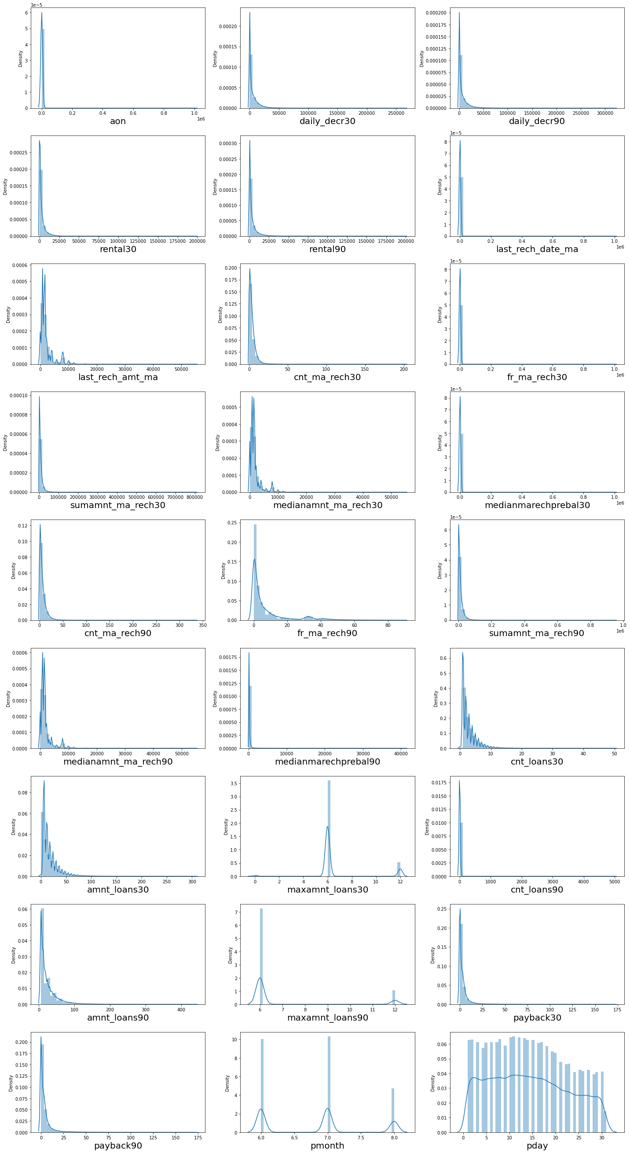
Visualization[Univariate]:

Slide 10
Visualization[Univariate]:
I can clearly see that there is skewness in most of the columns so we have to treat them.

Slide 11
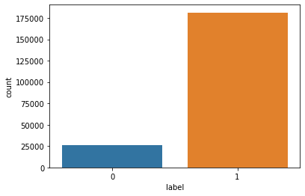
Vizualization[Univariate-Target]:
There is a data imbalancing issue so we have to treat this by using oversampling or undersampling.

Slide 12
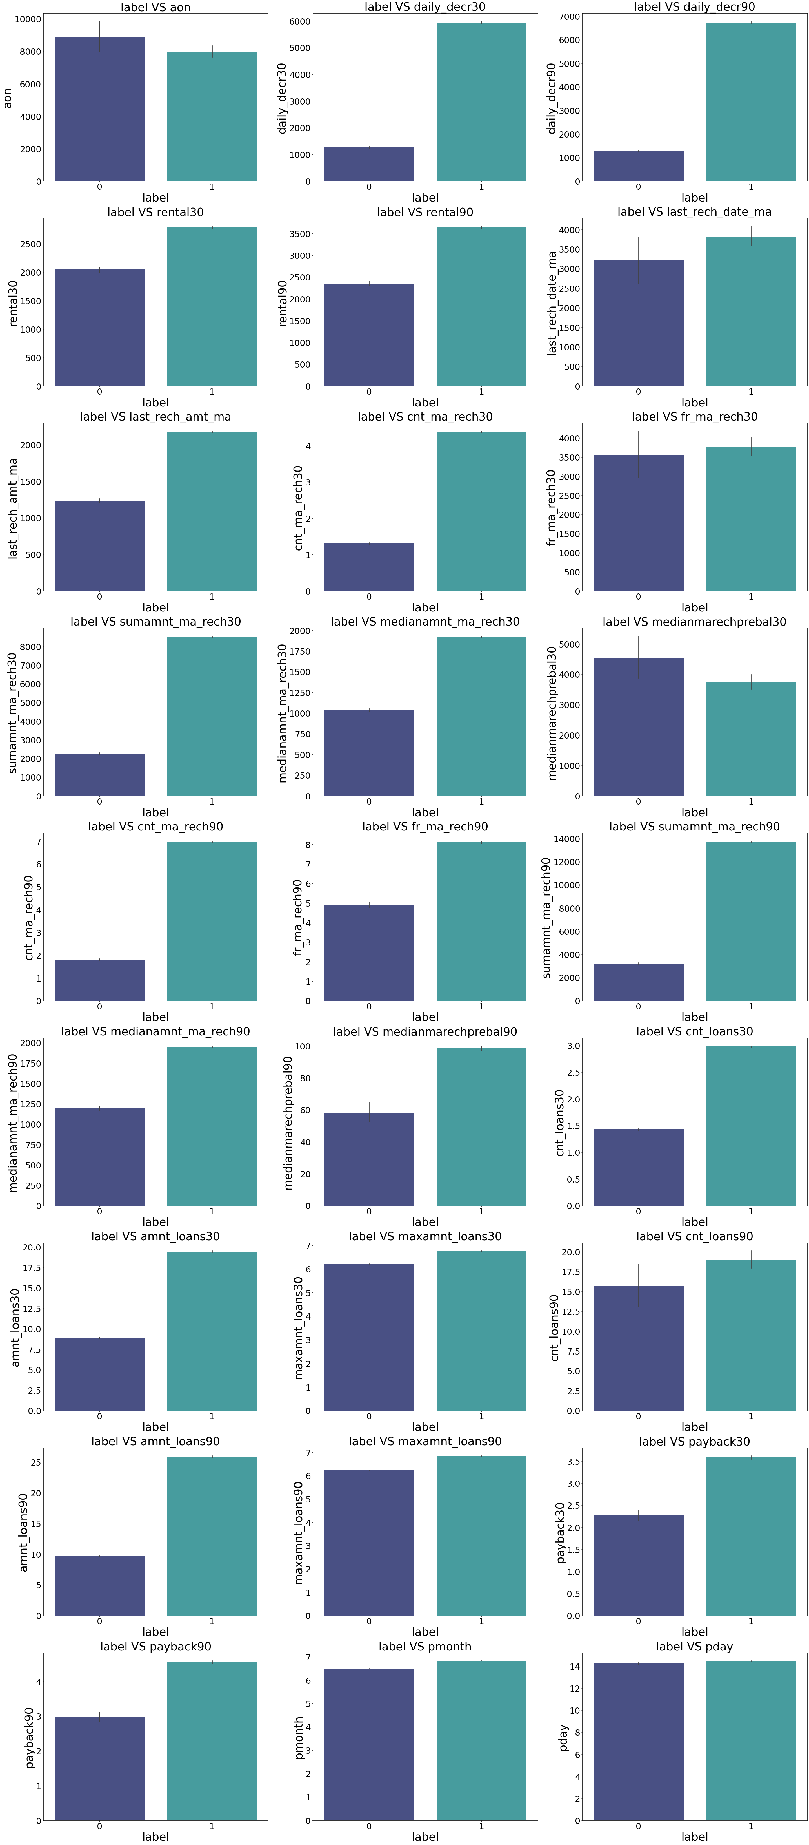
Vizualization[Bivariate]:

Slide 13
Observations:
1.Customers with high value of Age on cellular network in days(aon) are maximum defaulters(who have not paid there loan amount-0).
2.Customers with high value of Daily amount spent from main account, averaged over last 30 days (in Indonesian Rupiah)(daily_decr30) are maximum Non-defaulters(who have paid there loan amount-1).
3.Customers with high value of Daily amount spent from main account, averaged over last 90 days (in Indonesian Rupiah)(daily_decr90) are maximum Non-defaulters(who have paid there loan amount-1).
4.Customers with high value of Average main account balance over last 30 days(rental30) are maximum Non-defaulters(who have paid there loan amount-1).
5.Customers with high value of Average main account balance over last 90 days(rental90) are maximum Non-defaulters(who have paid there loan amount-1).
6.Customers with high Number of days till last recharge of main account(last_rech_date_ma) are maximum Non-defaulters(who have paid there loan amount-1).
7.Customers with high value of Amount of last recharge of main account (in Indonesian Rupiah)(last_rech_amt_ma) are maximum Non-defaulters(who have paid there loan amount-1).
8.Customers with high value of Number of times main account got recharged in last 30 days(cnt_ma_rech30) are maximum Non-defaulters(who have paid there loan amount-1).
9.Customers with high value of Frequency of main account recharged in last 30 days(fr_ma_rech30) are maximum Non-defaulters(who have paid there loan amount-1) and also the count is high for defaulters comparitively Non-defaulters are more in number.

Slide 14
Vizualization of numerical columns:

Slide 15
Observations:
10.Customers with high value of Total amount of recharge in main account over last 30 days (in Indonesian Rupiah)(sumamnt_ma_rech30) are maximum Non-defaulters(who have paid there loan amount-1).
11.Customers with high value of Median of amount of recharges done in main account over last 30 days at user level (in Indonesian Rupiah)(medianamnt_ma_rech30) are maximum Non-defaulters(who have paid there loan amount-1).
12.Customers with high value of Median of main account balance just before recharge in last 30 days at user level (in Indonesian Rupiah)(medianmarechprebal30) are maximum defaulters(who have not paid there loan amount-0).
13.Customers with high value of Number of times main account got recharged in last 90 days(cnt_ma_rech90) are maximum Non-defaulters(who have paid there loan amount-1).
14.Customers with high value of Frequency of main account recharged in last 90 days(fr_ma_rech90) are maximum Non-defaulters(who have paid there loan amount-1).
15.Customers with high value of Total amount of recharge in main account over last 90 days (in Indonasian Rupiah)(sumamnt_ma_rech90) are maximum Non-defaulters(who have paid there loan amount-1).
16.Customers with high value of Median of amount of recharges done in main account over last 90 days at user level (in Indonasian Rupiah)(medianamnt_ma_rech90) are maximum Non-defaulters(who have paid there loan amount-1).
17.Customers with high value of Median of main account balance just before recharge in last 90 days at user level (in Indonasian Rupiah)(medianmarechprebal90) are maximum Non-defaulters(who have paid there loan amount-1).
18.Customers with high value of Number of loans taken by user in last 30 days(cnt_loans30) are maximum Non-defaulters(who have paid there loan amount-1).

Slide 16
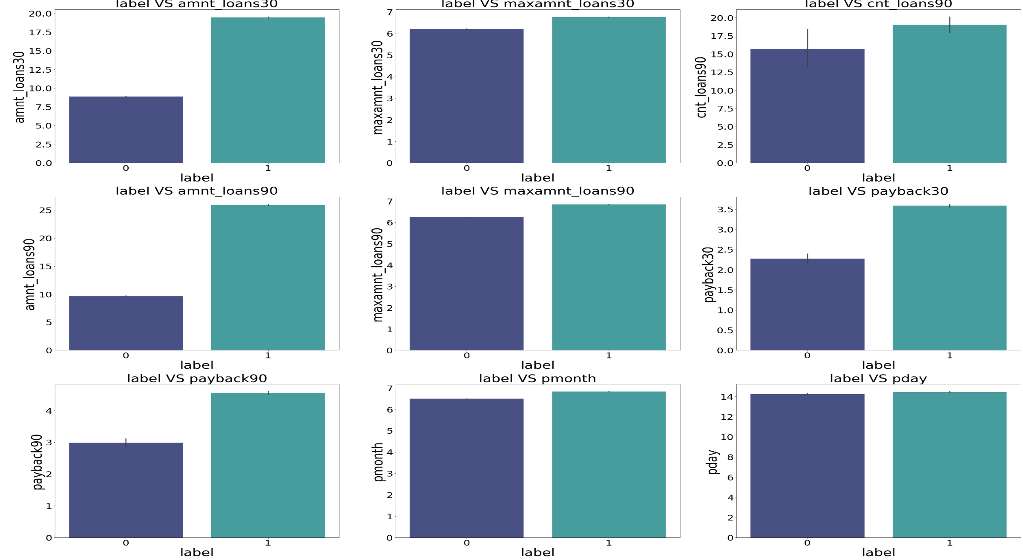
Vizualization of categorical columns:

Slide 17
Observations:
19.Customers with high value of Total amount of loans taken by user in last 30 days(amnt_loans30) are maximum Non-defaulters(who have paid there loan amount-1).
20.Customers with high value of maximum amount of loan taken by the user in last 30 days(maxamnt_loans30) are maximum Non-defaulters(who have paid there loan amount-1).
21.Customers with high value of Number of loans taken by user in last 90 days(cnt_loans90) are maximum Non-defaulters(who have paid there loan amount-1).
22.Customers with high value of Total amount of loans taken by user in last 90 days(amnt_loans90) are maximum Non-defaulters(who have paid there loan amount-1).
23.Customers with high value of maximum amount of loan taken by the user in last 90 days(maxamnt_loans90) are maximum Non-defaulters(who have paid there loan amount-1).
24.Customers with high value of Average payback time in days over last 30 days(payback30) are maximum Non-defaulters(who have paid there loan amount-1).
25.Customers with high value of Average payback time in days over last 90 days(payback90) are maximum Non-defaulters(who have paid there loan amount-1).
26.In between 6th and 7th month maximum customers both defualters and Non-defaulters have paid there loan amount.
27.Below 14th of each month all the customers have paid there loan amount.

Slide 18
Analysis:
I have used dist plot for each univariate numerical features and it says that there is skewness in almost all columns.
And also for bivariate numerical features I have used bar plot.
I found that in maximum features the count of non-defaulters is high compared to defaulters so the risk is less comparitively.

Slide 19
Data Cleaning Steps:
In my datasets I did not found null values, but I found outliers and also skewness.
To remove outliers I have used percentile method. And to remove skewness I have used yeo-johnson method.
To replace the negative values from positive values I have used abs.
Use of Pearson’s correlation coefficient to check the correlation between dependent and independent features.
Also I have used Normalization. Then followed by model building with all Classification algorithms.

Slide 20
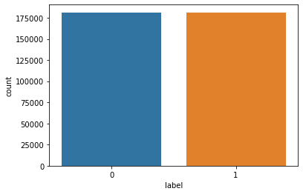
Data Balancing:
I have used oversampling (SMOTE) to get rid of data imbalancing. The balanced output looks like this.

Slide 21
Model Building:
Since Label was my target and it was a Categorical column, so this perticular problem was Classification problem. And I have used all Classification algorithms to build my model. By looking into the difference of accuracy score and cross validation score I found BaggingClassifier as a best model with least difference. Also to get the best model we have to run through multiple models and to avoid the confusion of overfitting we have go through cross validation. Below are the list of Classification algorithms I have used in my project.
XGBClassifier
DecisionTreeClassifier
BaggingClassifier
AdaBoostClassifier

Slide 22
Conclusion:
In this project report, we have used machine learning algorithms to predict the micro credit defaulters. We have mentioned the step by step procedure to analyze the dataset and finding the correlation between the features.
Thus we can select the features which are correlated to each other and are independent in nature. The power of visualization has helped us in understanding the data by graphical representation it has made me to understand what data is trying to say.
Data cleaning is one of the most important steps to remove unrealistic values and zero values.
These feature set were then given as an input to four algorithms and a hyper parameter tunning was done to the best model and the accuracy has been improved. Hence we calculated the performance of each model using different performance metrics and compared them based on these metrics.
Then we have also saved the best model and predicted the label. It was good the the predicted and actual values were almost same.
To conclude, the application of machine learning in micro credit is still at an early stage. We hope this study has moved a small step ahead in providing some methodological and empirical contributions to crediting institutes, and presenting an alternative approach to the valuation of defaulters.
Future direction of research may consider incorporating additional micro credit transaction data from a larger economical background with more features.

Slide 23


